Slide 1

662-260-4724 southernstatesfire.com

Slide 2
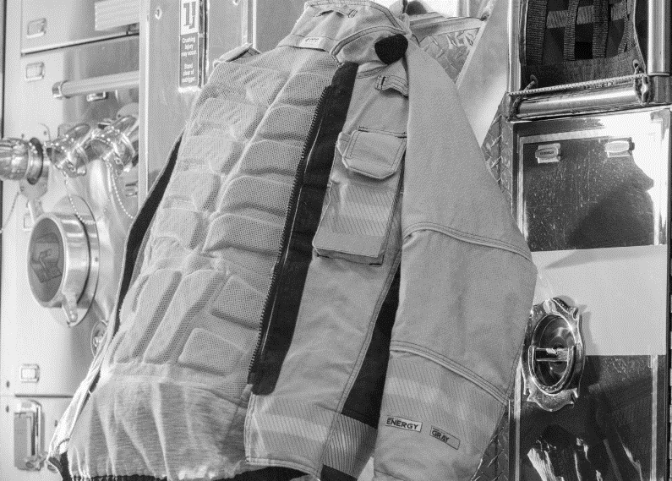
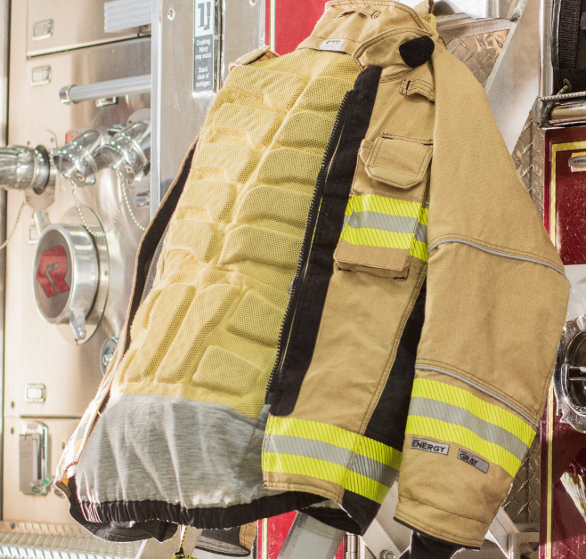

INNOTEX® AIRLFOW™
Airpack Cushion
3D padding reduces the discomfort
of wearing the SCBA. Constructed of closed cell foam that will not absorb moisture. Keeping you cooler and more comfortable.
COOLING VENTILATION CHANNELS
Allows air circulation throughout multiples channels. Reducing the
Possibility of compression burns.
US Patent 10,245,454

Slide 3
INNOTEX® AIRLFOW™
Strategically Placed
The 3D padding is placed on shoulders and back. Ergonomically designed for maximum flexibility, so the body can move freely.
Lightweight and Durable
Extremely lightweight closed-cell foam is coupled with an ultra-resistant Kevlar® mesh lining. Extremely durable and maintenance-free.
US Patent 10,245,454

Slide 4
662-347-1059 southernstatesfire.com
Call Today to Schedule a Demo

